Slide 1
DEL BIGTREE
Vaccines: Science vs. Religion
@DelBigtree
@HighWireTalk

Slide 3
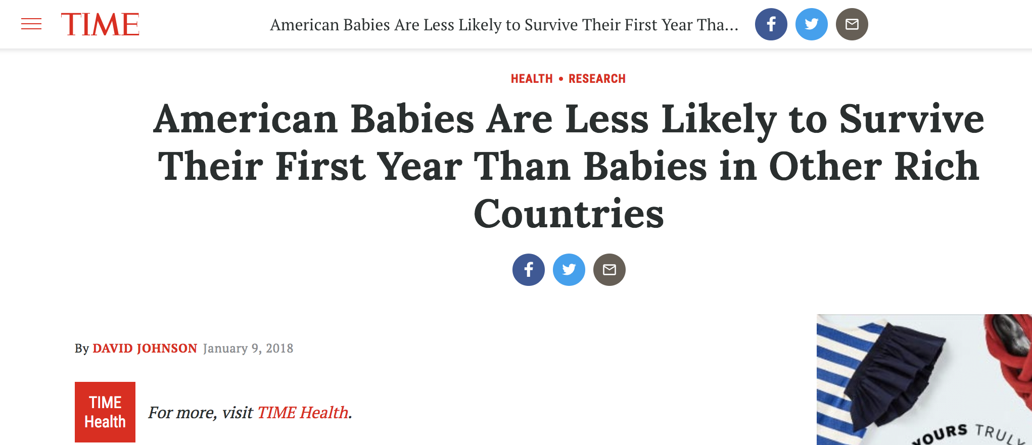

Slide 4
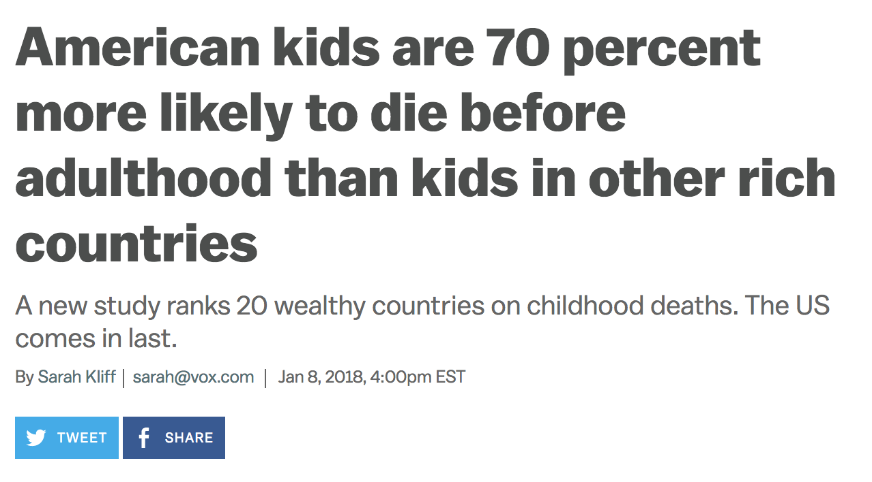

Slide 5
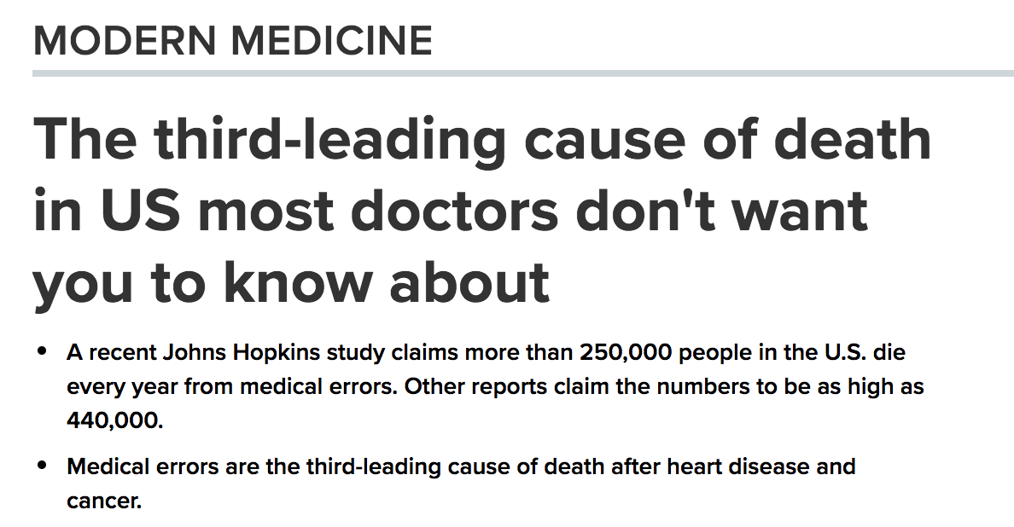

Slide 6
science
noun sci·ence \ ˈsī-ən(t)s \
Popularity: Top 1% of lookups |Updated on: 12 May 2018
knowledge or a system of knowledge covering general truths or the operation
of general laws especially as obtained and tested through scientific method

Slide 7
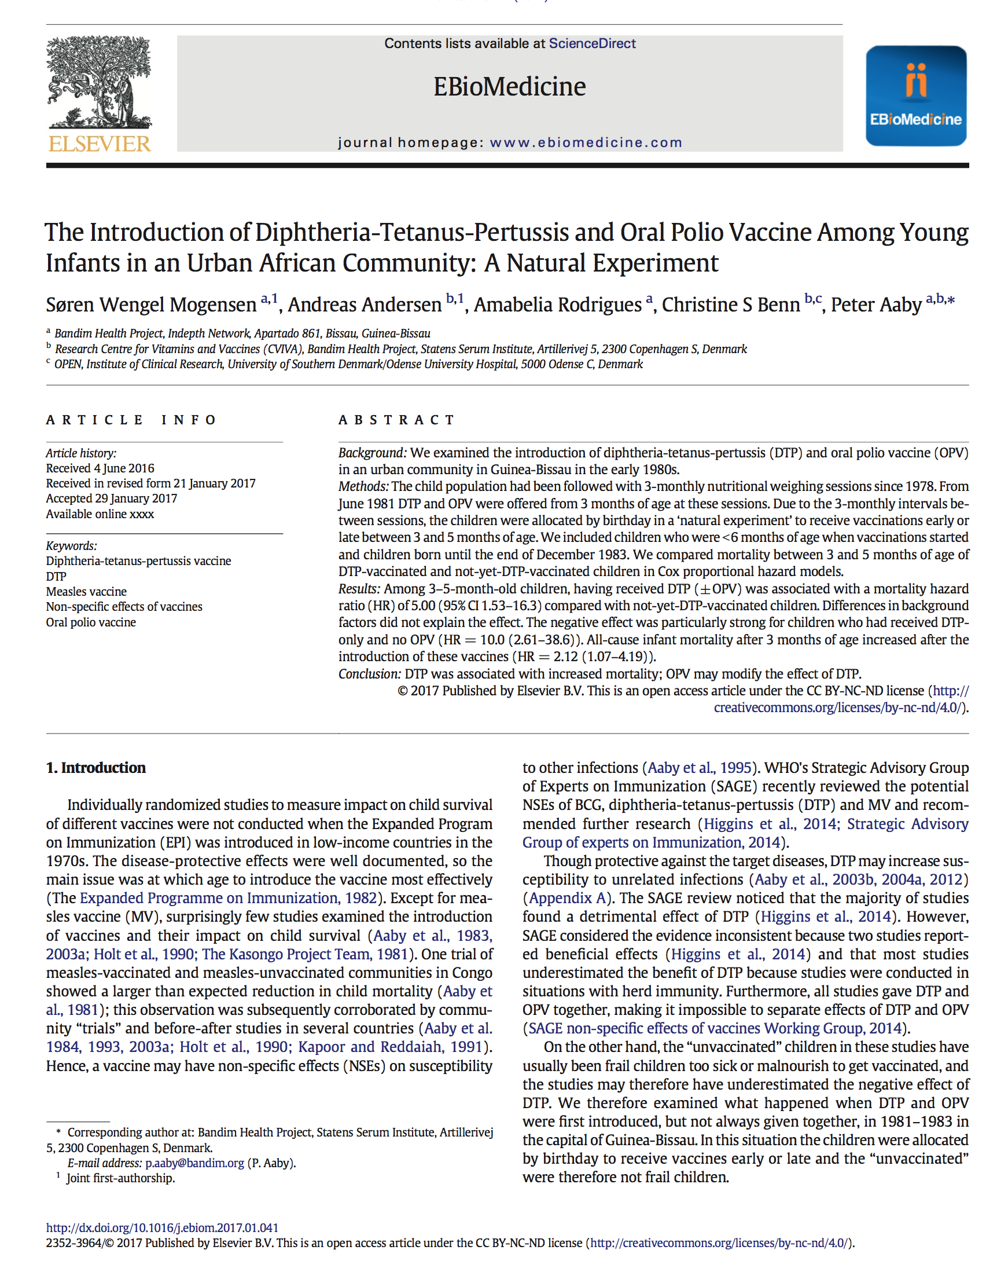
10x

Slide 8
Short list of Vaccine Adverse Events
(Compensated in Vaccine Court)
Guillain-Barre Syndrome (GBS)
Transverse Myelitis
Encephalopathy
Seizure Disorder
Death
Brachial Neuritis
Acute Disseminated Encephalomyelitis Chronic Inflammatory Demyelinating Polyradiculoneuropathy (CIDP)
Premature Ovarian Failure
Bell’s Palsy
Idiopathic Thrombocytopenic Purpura (ITP)
Juvenile Diabetes
Rheumatoid Arthritis
Multiple Sclerosis (MS)
Fibromyalgia
Infantile Spasms
Anaphylaxis
Ocular Myasthenia Gravis
Hypoxic Seizure
Asthma
Eczema
Tics
Tourette Syndrome
OCD
ADD
Speech Delay
Narcolepsy
Epilepsy
Multiple Sclerosis
Allergies
(Listed on Vaccine Inserts)
Autoimmune Diseases
Allergies
Asthma
Eczema
Juvenile Diabetes
Rheumatoid Arthritis
Rhinitis
Insomnia
Autism
Lupus
Myelitis
Optic Neuritis
SIDS
Seizure Disorder
Multiple Sclerosis
Celiac Disease
Kawasaki Disease
Stevens-Johnson Syndrome

Slide 9
According to the CDC:
1 in 6 children has a developmental disability
*
ADD
ADHD
Autism
Hearing Loss
Learning Disability
Mental Disability
Seizures
Stammering
Stuttering
According to an HHS Funded Publication:
54% of children have chronic illness
†
Anxiety Problems
Asthma
Behavioral Problems
Bone and Muscle Disorders
Chronic Ear Infections
Depression
Diabetes
Digestive Allergies
Environmental Allergies
Epilepsy
Rheumatoid Arthritis
Seizure Disorder
*Source: https://www.cdc.gov/ncbddd/developmentaldisabilities/about.html
†Bethel et. al, 2011, A National and State Profile of Leading Health Problems and Health Care Quality for US Children: Key Insurance Disparities and Across-State Variations, Academic Pediatrics.

Slide 10
Number of Childhood Vaccine
Injections Administered
Childhood Chronic Illness &
Developmental Disability Prevalence
11
54
12.8%
†
*
54%
1986 schedule
2017 schedule
1986 prevalence
2011 prevalence
* Cleave et. al, 2010, Dynamics of Obesity and Chronic Health Conditions Among Children and Youth, JAMA.
†Bethel et. al, 2011, A National and State Profile of Leading Health Problems and Health Care Quality for US Children: Key Insurance Disparities and Across-State Variations, Academic Pediatrics.

Slide 11
I.
II.
III.
IV.
Intro
Who is Responsible for Vaccine Safety
Structural Conflicts of Interest in Vaccine Safety
Post-Licensure Vaccine Safety Surveillance
Simple & Immediate Solutions

Slide 12
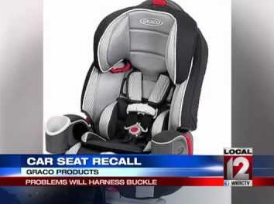
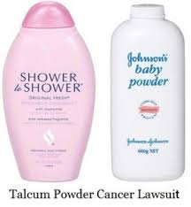
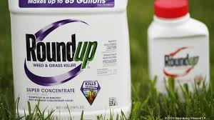
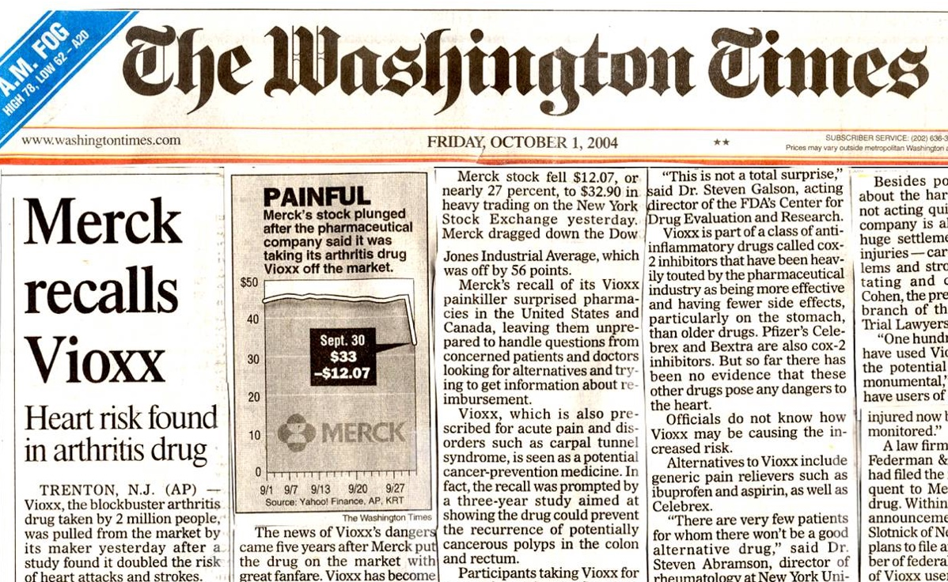
Warning contains Asbestos
Ovarian Cancer
Non Hodgkin Lymphoma
Heart Attack
Who is Responsible for Vaccine Safety?

Slide 13
8
National Childhood Vaccine Injury Act
The 1986 Act
Immunity from Liability

Slide 14
National Childhood Vaccine Injury Act
Consequences?
No incentive to conduct safety studies
Liability free market of 78 million American children
Strong incentive to develop more vaccines

Slide 15
11
1986
2017
Near Future
11 Vaccines
54 Vaccines
100s of Vaccines
DTaP (2 months)
Polio (2 months)
Hib (2 months)
PCV (2 months)
Rotavirus (2 months)
DTaP (4 months)
Polio (4 months)
Hib (4 months)
PCV (4 months)
Rotavirus (4 months)
Influenza (pregnancy)
Tdap (pregnancy)
Hepatitis B (one day)
Hepatitis B (one month)
DTaP (2 months)
Polio (2 months)
Hib (2 months)
PCV (2 months)
Rotavirus (2 months)
DTaP (4 months)
Polio (4 months)
Hib (4 months)
PCV (4 months)
Rotavirus (4 months)
DTaP (6 months)
Polio (6 months)
Hepatitis B (6 months)
Hib (6 months)
PCV (6 months)
Rotavirus (6 months)
Influenza (6 months)
MMR (12 months)
Varicella (12 months)
Hib (12 months)
Hepatitis A (12 months)
PCV (12 months)
DTaP (15 months)
Hepatitis A (18 months)
Influenza (18 months)
Influenza (2 years)
Influenza (3 years)
Influenza (4 years)
DTaP (4 years)
MMR (4 years)
Rubella (4 years)
Varicella (4 years)
Influenza (5 years)
Influenza (6 years)
Influenza (7 years)
Influenza (8 years)
Influenza (9 years)
Influenza (10 years)
HPV (11 years)
Influenza (11 years)
TDaP (11 years)
HPV (11 ½ years)
Influenza (12 years)
HPV (12 years)
Influenza (13 years)
Influenza (14 years)
Influenza (15 years)
MCV (16 years)
Influenza (16 years)
MenB (16 years)
Influenza (17 years)
Influenza (18 years)
Influenza (pregnancy)
Tdap (pregnancy)
Hepatitis B (one day)
Hepatitis B (one month)
DTaP (2 months)
Polio (2 months)
Hib (2 months)
PCV (2 months)
Rotavirus (2 months)
DTaP (4 months)
Polio (4 months)
Hib (4 months)
PCV (4 months)
Rotavirus (4 months)
DTaP (6 months)
Polio (6 months)
Hepatitis B (6 months)
Hib (6 months)
PCV (6 months)
Rotavirus (6 months)
Influenza (6 months)
MMR (12 months)
Varicella (12 months)
Hib (12 months)
Hepatitis A (12 months)
PCV (12 months)
DTaP (15 months)
Hepatitis A (18 months)
Influenza (18 months)
Influenza (2 years)
Influenza (3 years)
Influenza (4 years)
DTaP (4 years)
MMR (4 years)
Rubella (4 years)
Varicella (4 years)
Influenza (5 years)
Influenza (6 years)
Influenza (7 years)
Influenza (8 years)
Influenza (9 years)
Influenza (10 years)
HPV (11 years)
Influenza (11 years)
TDaP (11 years)
HPV (11 ½ years)
Influenza (12 years)
HPV (12 years)
Influenza (13 years)
Influenza (14 years)
Influenza (15 years)
MCV (16 years)
Influenza (16 years)
MenB (16 years)
Influenza (17 years)
Influenza (18 years)
Influenza (pregnancy)
Tdap (pregnancy)
Hepatitis B (one day)
Hepatitis B (one month)
DTaP (2 months)
Polio (2 months)
Hib (2 months)
PCV (2 months)
Rotavirus (2 months)
DTaP (4 months)
Polio (4 months)
Hib (4 months)
PCV (4 months)
Rotavirus (4 months)
DTaP (6 months)
Polio (6 months)
Hepatitis B (6 months)
Hib (6 months)
PCV (6 months)
Rotavirus (6 months)
Influenza (6 months)
MMR (12 months)
Varicella (12 months)
Hib (12 months)
Hepatitis A (12 months)
PCV (12 months)
DTaP (15 months)
Influenza (pregnancy)
Tdap (pregnancy)
Hepatitis B (one day)
Hepatitis B (one month)
DTaP (2 months)
Polio (2 months)
Hib (2 months)
PCV (2 months)
Rotavirus (2 months)
DTaP (4 months)
Polio (4 months)
Hib (4 months)
PCV (4 months)
Rotavirus (4 months)
DTaP (6 months)
Polio (6 months)
Hepatitis B (6 months)
Hib (6 months)
PCV (6 months)
Rotavirus (6 months)
Influenza (6 months)
MMR (12 months)
Varicella (12 months)
Hib (12 months)
Hepatitis A (12 months)
PCV (12 months)
DTaP (15 months)
Hepatitis A (18 months)
Influenza (18 months)
Influenza (2 years)
Influenza (3 years)
Influenza (4 years)
DTaP (4 years)
MMR (4 years)
Rubella (4 years)
Varicella (4 years)
Influenza (5 years)
Influenza (6 years)
Influenza (7 years)
Influenza (8 years)
Influenza (9 years)
Influenza (10 years)
HPV (11 years)
Influenza (11 years)
TDaP (11 years)
HPV (11 ½ years)
Influenza (12 years)
HPV (12 years)
Influenza (13 years)
Influenza (14 years)
Influenza (15 years)
MCV (16 years)
Influenza (16 years)
MenB (16 years)
Influenza (17 years)
Influenza (18 years)
Influenza (pregnancy)
Tdap (pregnancy)
Hepatitis B (one day)
Hepatitis B (one month)
DTaP (2 months)
Polio (2 months)
Hib (2 months)
PCV (2 months)
Rotavirus (2 months)
DTaP (4 months)
Polio (4 months)
Hib (4 months)
PCV (4 months)
Rotavirus (4 months)
DTaP (6 months)
Polio (6 months)
Hepatitis B (6 months)
Hib (6 months)
PCV (6 months)
Rotavirus (6 months)
Influenza (6 months)
MMR (12 months)
Varicella (12 months)
Hib (12 months)
Hepatitis A (12 months)
PCV (12 months)
DTaP (15 months)
Influenza (pregnancy)
Tdap (pregnancy)
Hepatitis B (one day)
Hepatitis B (one month)
DTaP (2 months)
Polio (2 months)
Hib (2 months)
PCV (2 months)
Rotavirus (2 months)
DTaP (4 months)
Polio (4 months)
Hib (4 months)
PCV (4 months)
Rotavirus (4 months)
DTaP (6 months)
Polio (6 months)
Hepatitis B (6 months)
Hib (6 months)
PCV (6 months)
Rotavirus (6 months)
Influenza (6 months)
MMR (12 months)
Varicella (12 months)
Hib (12 months)
Hepatitis A (12 months)
PCV (12 months)
DTaP (15 months)
Hepatitis A (18 months)
Influenza (18 months)
Influenza (2 years)
Influenza (3 years)
Influenza (4 years)
DTaP (4 years)
MMR (4 years)
Rubella (4 years)
Varicella (4 years)
Influenza (5 years)
Influenza (6 years)
Influenza (7 years)
Influenza (8 years)
Influenza (9 years)
Influenza (10 years)
HPV (11 years)
2013- Pharma 271 Under Dev
2017- 2300 Clinical Trials

Slide 16
National Childhood Vaccine Injury Act
Who is responsible for vaccine safety?
HHS

Slide 17
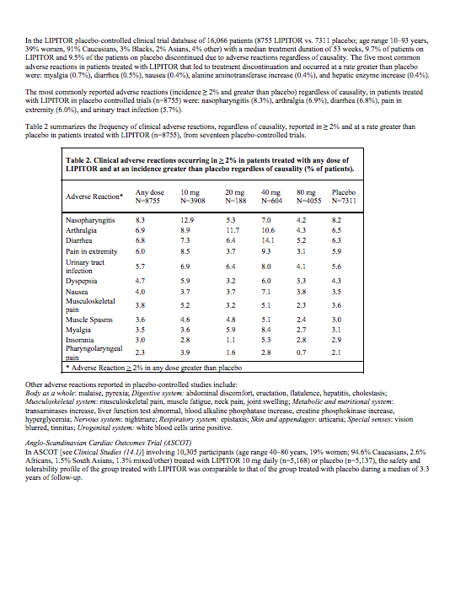
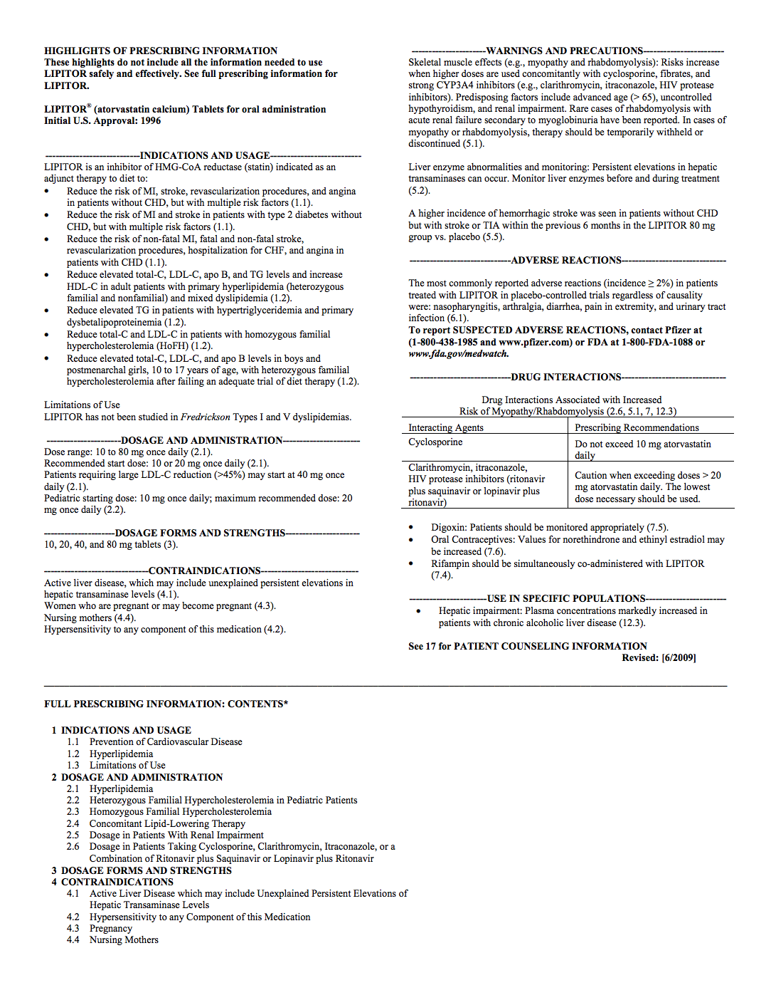
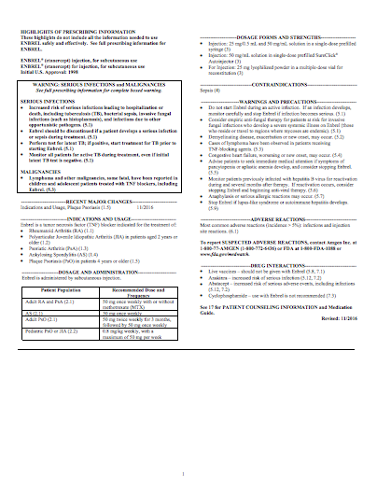
How Vaccines are Licensed, Recommended, Promoted, Defended
Product | Safety Review Period Prior to Licensure | Placebo Group
Lipitor | 4.8 Years | Sugar Pill
Enbrel | 6.6 Years | Saline Injection

Slide 18
How Vaccines are Licensed, Recommended, Promoted, Defended
Recommended Age (First Dose) | Vaccine/ Manufacturer | Safety Review Period Prior to Licensure | Subject Group | Placebo Group
1 Day Old | Hep-B (Engerix)/ GlaxoSmithKline | 4 Days | Hep-B | No Placebo
1 Day Old | Hep-B (Recombivax)/ Merck | 5 Days | Hep-B | No Placebo

Slide 19
How Vaccines are Licensed, Recommended, Promoted, Defended
Recommended Age (First Dose) | Vaccine/ Manufacturer | Safety Review Period Prior to Licensure | Subject Group | Placebo Group
1 Day Old | Hep-B (Engerix)/ GlaxoSmithKline | 4 Days | Hep-B | No Placebo
1 Day Old | Hep-B (Recombivax)/ Merck | 5 Days | Hep-B | No Placebo
2 Month Old | Polio (PVI- Monkey Kidney)/ Sanofi Pasteur | 48 hours | Polio + DTP | DTP

Slide 21
religion
noun re·li·gion \ ri-ˈli-jən \
Popularity: Top 1% of lookups |Updated on: 12 May 2018
a cause, principle, or system of beliefs held to with ardor and faith

Slide 22
How Vaccines are Licensed, Recommended, Promoted, Defended
Advisory Committee on Immunization Practices (“ACIP”)
An ACIP vote to recommend a vaccine results in:
Mandating the vaccine to millions of children.
Immunity from liability for the manufacturer.
Inclusion in the Vaccine for Children program.
Liability free captive market of 78 million American children with guaranteed payment

Slide 23
How Vaccines are Licensed, Recommended, Promoted, Defended
2000 - Investigation Into ACIP by U.S. Government Reform Committee:
“The CDC grants blanket waivers to the ACIP members each year that allow them to deliberate on any subject, regardless of their conflicts, for the entire year.”
ACIP reflects “a system where government officials make crucial decisions affecting American children without the advice and consent of the governed.”

Slide 26
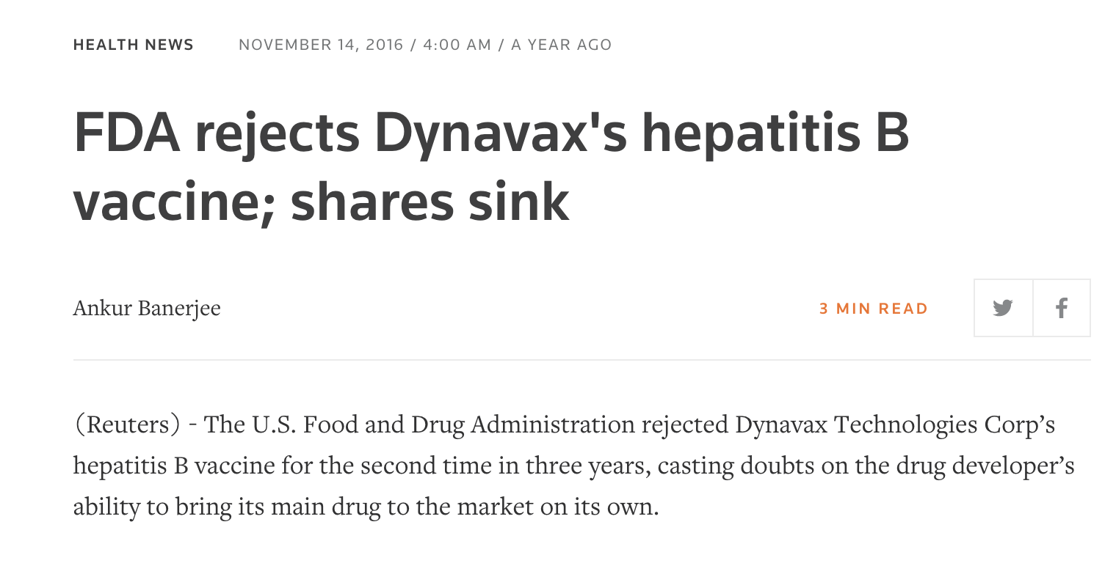

Slide 27
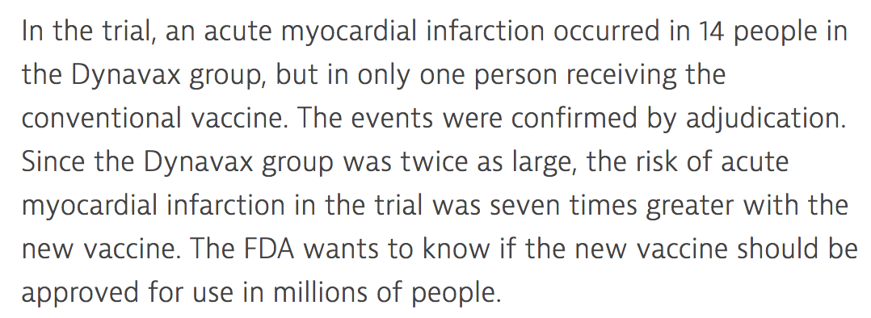

Slide 28
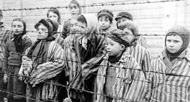

Slide 29
cult
noun, often attributive \ ˈkəlt \
Popularity: Top 1% of lookups |Updated on: 6 May 2018
great devotion to a person, idea, object, movement, or work

Slide 30
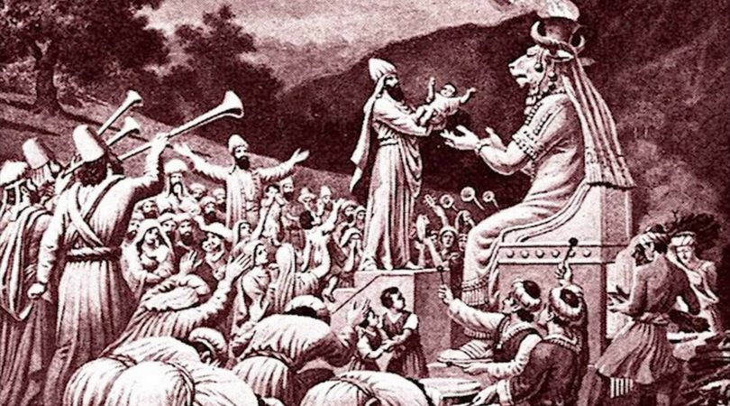

Slide 33
31% Vaccine
Failure

Slide 34
53% Adults

Slide 35
30% Cases
Vaccine
Strain

Slide 36
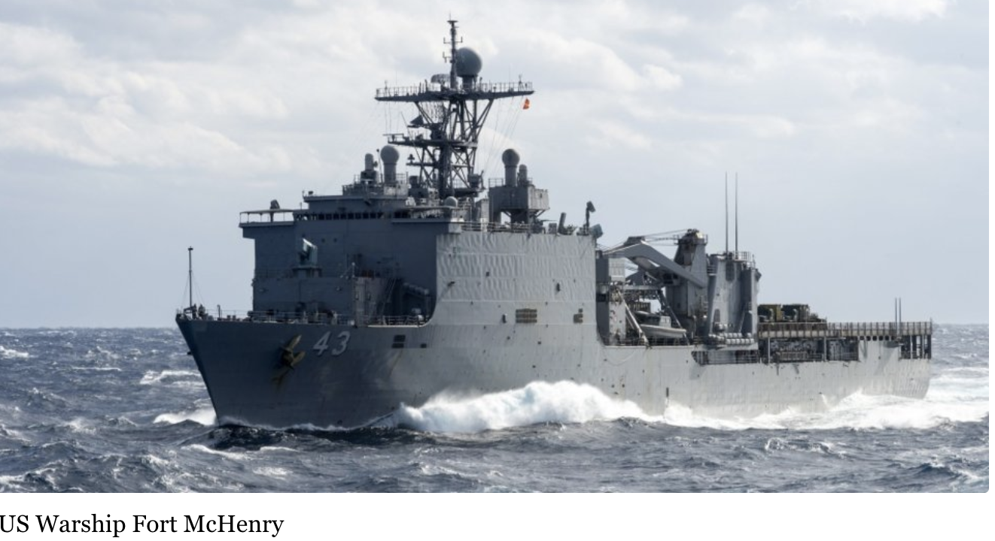

Slide 37
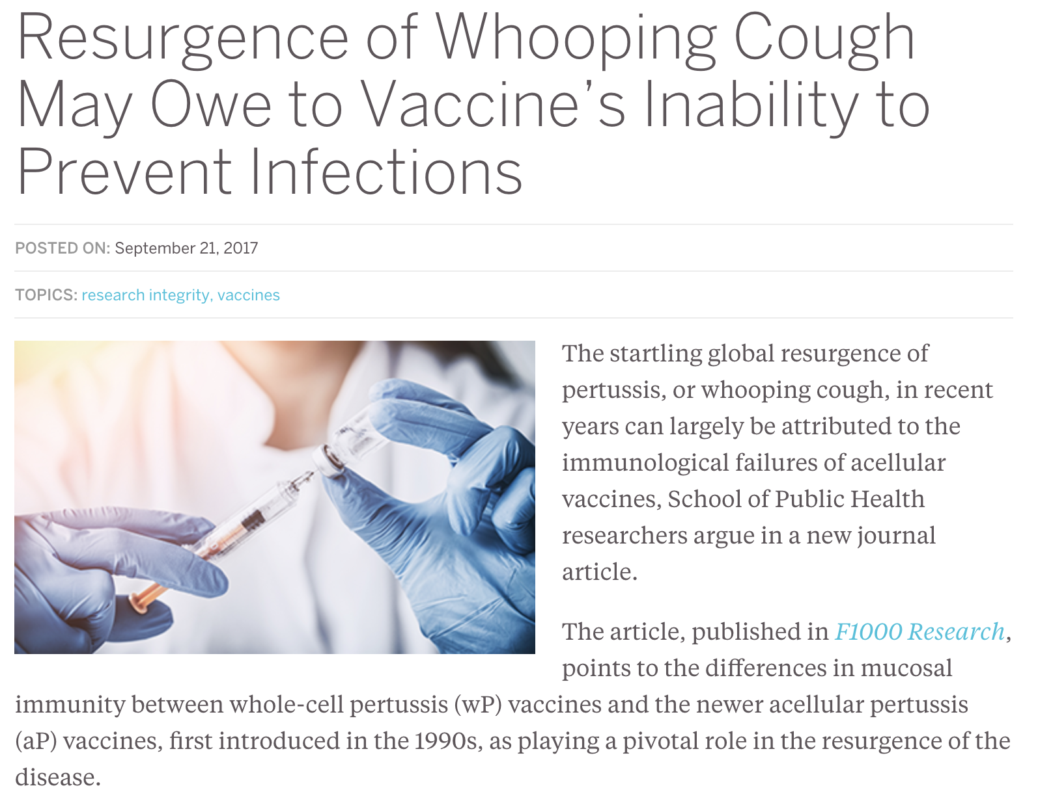

Slide 39
I.
II.
III.
IV.
Intro
Who is Responsible for Vaccine Safety
Structural Conflicts of Interest in Vaccine Safety
Post-Licensure Vaccine Safety Surveillance
Simple & Immediate Solutions

Slide 41
1986 Act: Vaccine Adverse Events Reporting System (VAERS)
5,911,700
In 2016, VAERS received 59,117 reports including:
43,200
109,100
413,200
1,028,400
432 deaths,
1,091 permanent disabilities,
4,132 hospitalizations, and
10,284 emergency room visits.
“fewer than 1% of adverse events are reported”
(Source: Report Funded by HHS)
“Former FDA Commissioner David A. Kessler has estimated that VAERS reports currently represent only a fraction of the serious adverse events.”
(Source: U.S. Congressional Report)

Slide 42
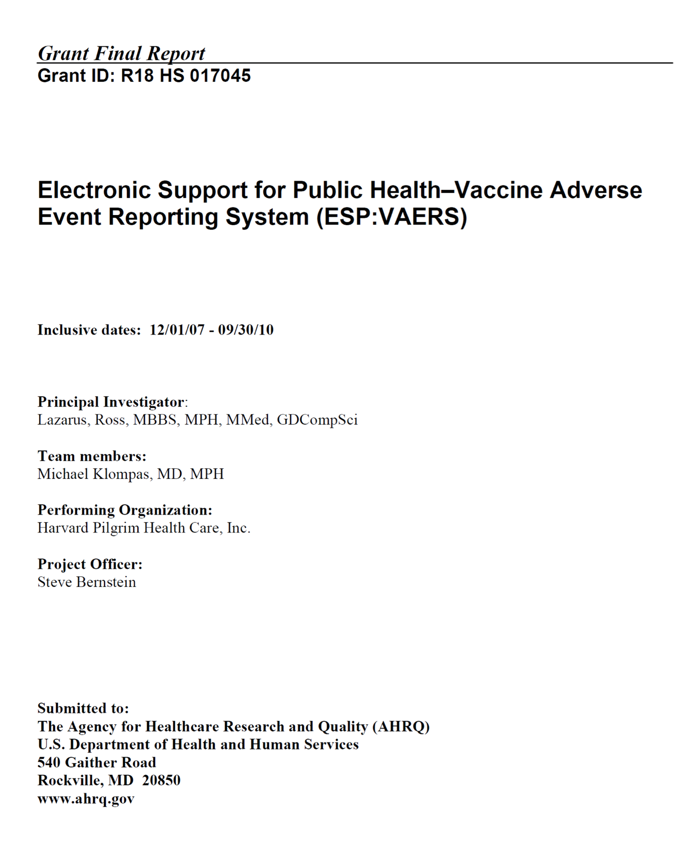
AUTOMATING VAERS

Slide 43
AUTOMATING VAERS

Slide 44
Lack of Vaccine Safety Science
Dr. Bernadine Healy, Former Head of NIH

Slide 45
Lack of Vaccine Safety Science
Institute of Medicine Reports on Vaccine Safety
Year of IOM Report | Vaccines Reviewed | # of Conditions Studied | Literature Supports Causation | Literature Rejects Causation | Literature Inadequate to Accept or Reject Causation
1991 | DTP | 22 | 6 | 4 | 12
Aseptic meningitis; Chronic neurologic damage; Learning disabilities and attention-deficit disorder; Hemolytic anemia; Juvenile diabetes; Guillain-Barre syndrome; Erythema multiforme; Peripheral mononeuropathy; Radiculoneuritis and other neuropathies; Thrombocytopenia; Thrombocytopenic purpura

Slide 46
Lack of Vaccine Safety Science
Institute of Medicine Reports on Vaccine Safety
Year of IOM Report | Vaccines Reviewed | # of Conditions Studied | Literature Supports Causation | Literature Rejects Causation | Literature Inadequate to Accept or Reject Causation
1994 | DT, MM, Hep-B & Hib | 54 | 12 | 4 | 38
A partial list of the 38 conditions: Demyelinating diseases of the central nervous system, Sterility, Arthritis, Neuropathy, Residual seizure disorder, Transverse myelitis, Sensorineural deafness, Optic neuritis, Aseptic meningitis, Insulin-dependent diabetes mellitus, SIDS

Slide 47
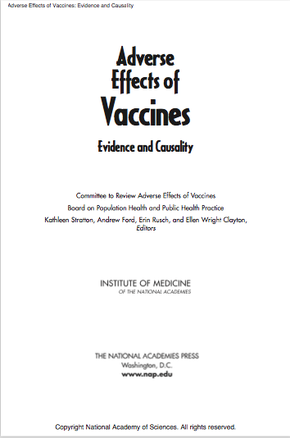
Lack of Vaccine Safety Science
Institute of Medicine Reports on Vaccine Safety
Year of IOM Report | Vaccines Reviewed | # of Conditions Studied | Literature Supports Causation | Literature Rejects Causation | Literature Inadequate to Accept or Reject Causation
2011 | Varicella, T, Hep-B, MMR | 155 | 16 | 5 | 134
A partial list of the 134 conditions: Encephalitis, Encephalopathy, Infantile Spasms, Afebrile Seizures, Seizures, Cerebellar Antaxia, Anataxia, Autism, Acute Disseminated Encephalomyelitis, Transverse Myelitis, Optic Neuritis, Neuromyelitis Optica, Multiple Sclerosis, Guillain-Barre Syndrome, Chronic Inflammatory Demyelinating Polyneuropathy, Brachial Neuritis, Amyotrophic Lateral Sclerosis, Small Fiber Neuropathy, Chronic Urticaria, Erythema Nodosum, Systemic Lupus Erythematosus, Polyarteritis Nodosa, Psoriatic Arthritis, Reactive Arthritis, Rheumatoid Arthritis, Juvenile Idiopathic Arthritis, Arthralgia, Autoimmune Hepatitis, Stroke, Chronic Headache, Fibromyalgia, Sudden Infant Death Syndrome, Hearing Loss, Thrombocytopenia, Immune Thrombocytopenic Purpura

Slide 48
Lack of Vaccine Safety Science
Institute of Medicine Reports on Vaccine Safety
2011 IOM Report

Slide 49
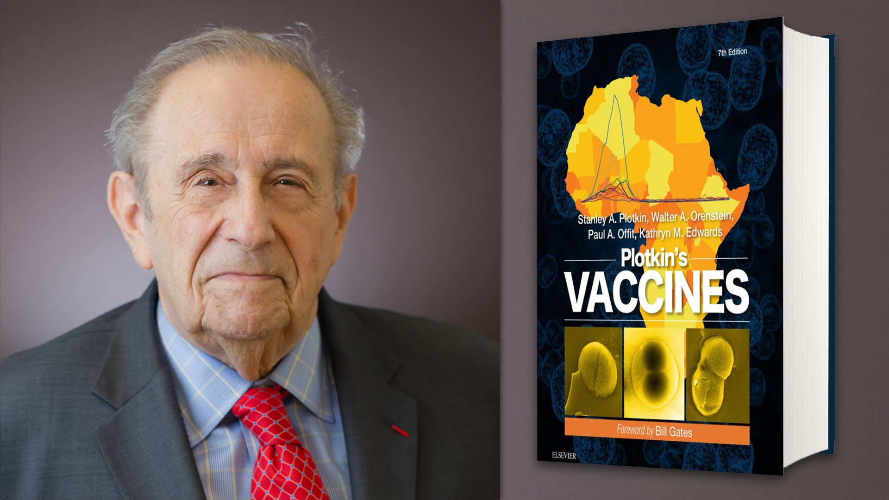

Slide 51
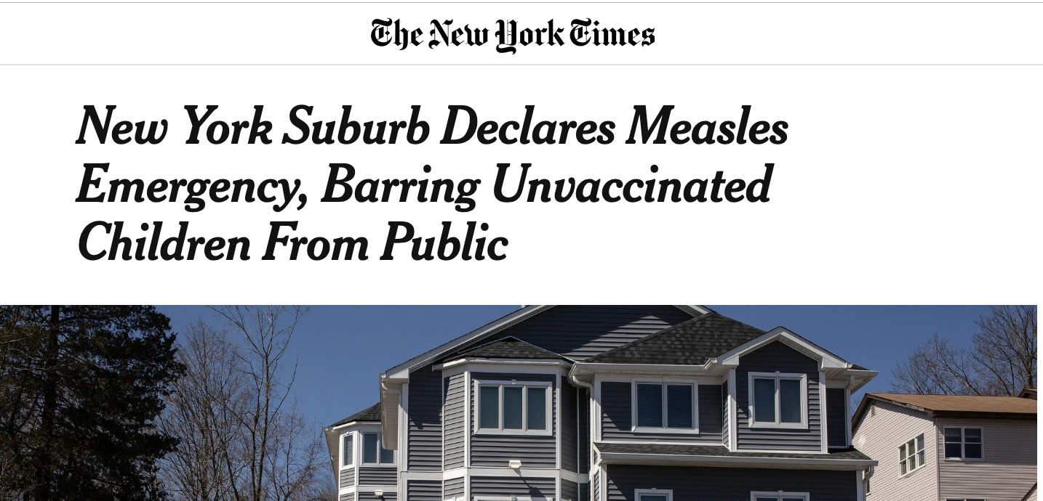

Slide 56
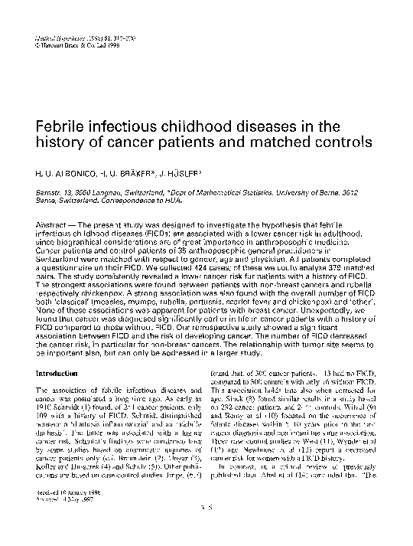
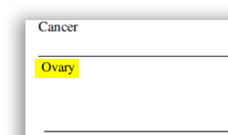
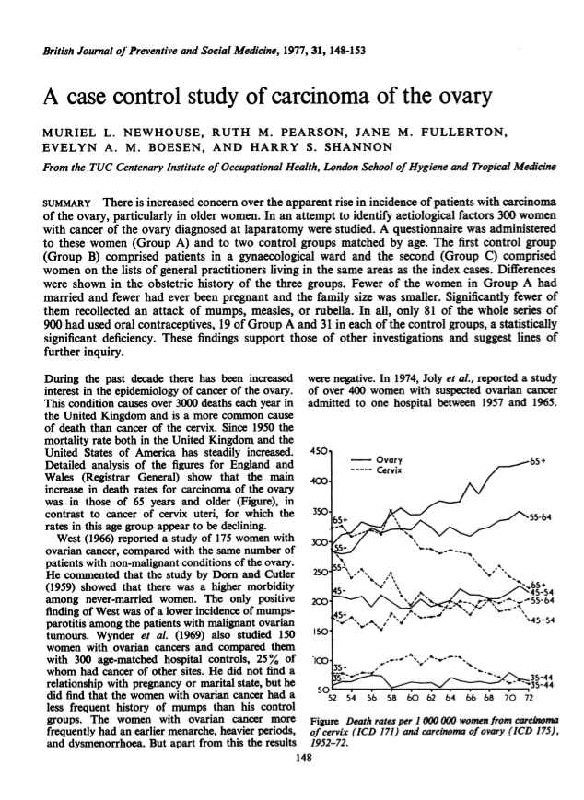
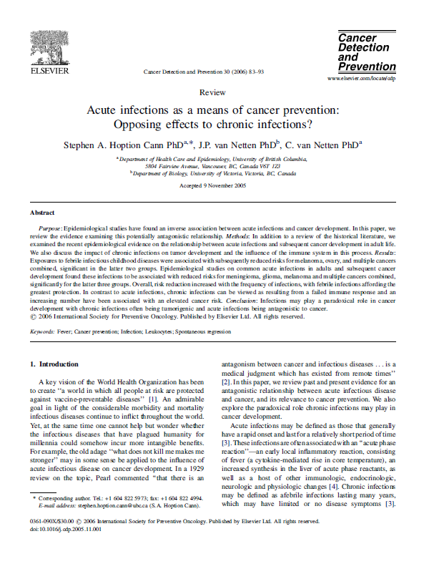
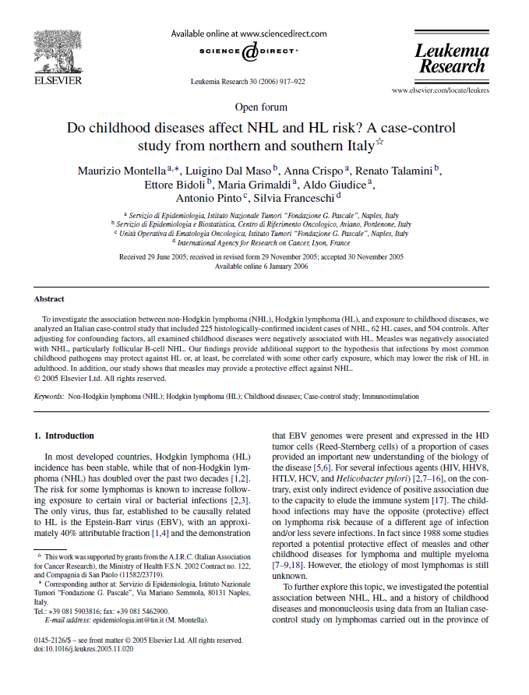
56
Measles Reduces Risk of Cancer

Slide 57
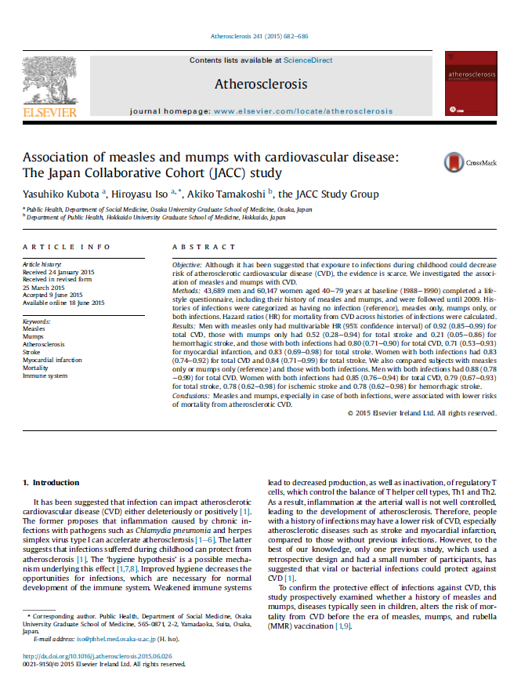
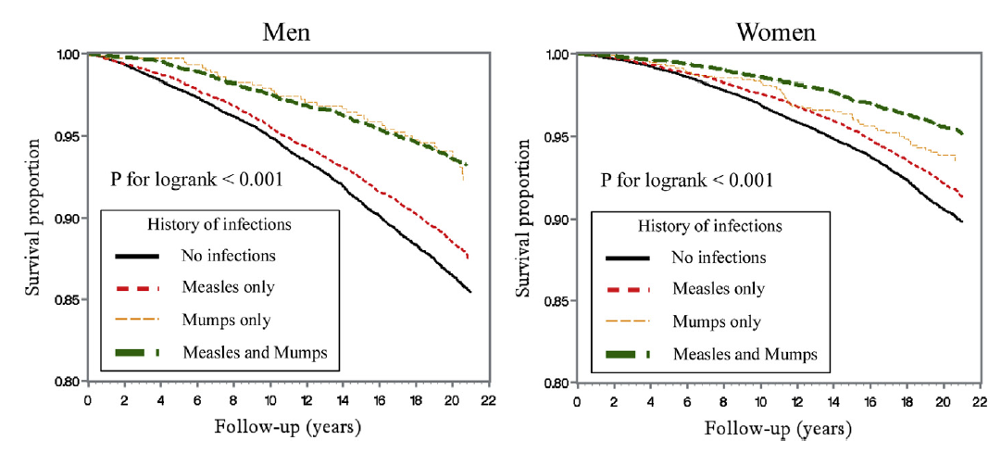

Slide 58
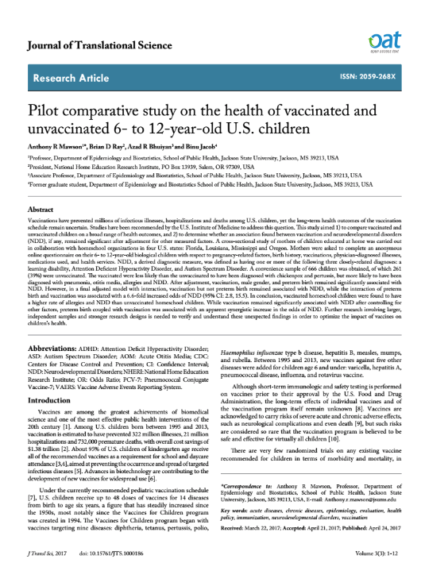
Vaccinated vs. Unvaccinated Study (Homeschoolers, 2017)
Odds ratio of chronic diseases for vaccinated children vs. unvaccinated children
Rhinitis
30
Learning
Disability
5.2
ADHD
4.2
Autism
4.2
Neurodev.
Disorder
3.7
Allergy
3.9
Eczema
2.9
600 kids

Slide 59
For A Copy of This PowerPoint
and supporting documents
TEXT: 33 222
MESSAGE: ICAN
WATCH
The HighWire w/Del Bigtree
Thursdays 11am PST

